Slide 1


VSDS Member Database
Holden Cormier & Preston Button

Slide 2

Problem Statement
Build a database that can be used to keep track of every member that has been a member of VSDS. We wanted a singular location of everyone that has been a member, in addition to who is currently a member and the current leadership structure.

Slide 3
Business Rules
a. The membership consists of all club members and keeps track of their names, year, major, email, Discord, and GitHub username. Their email, Discord, and GitHub are all unique values.
b. The club is managed by the Exec board. The club can only have one exec board. It is described by the members who are on the Exec board. These members have a term number and a Position
c. The exec board is led by a president. There can only be one president. The president has a term number and any special privileges they have acquired.
d. The database keeps track of all projects, their name, their GitHub repo address, their languages, and whether or not the project is complete, has been started, and timeline. Each project name and github address is unique.
e. The Issues table contains an issue number, issue tag, comment, sprint, difficulty, is_complete, and is started. The issue number is unique.
f. The president must manage many exec board members. Exec board members must be managed by a president.
g. The president must manage many general body members. General body members must be managed by a president.
h. Many exec board members must manage many general body members. General body members must be managed by many exec board members.
i. Each project must be planned by many exec board members, many exec board members may plan one project.
j. Members may work on one project. A project may have many members working on it.
k. A member may claim many issues. An issue may be claimed by one member
l. A project may contain many issues. An issue must be contained within a project.

Slide 4
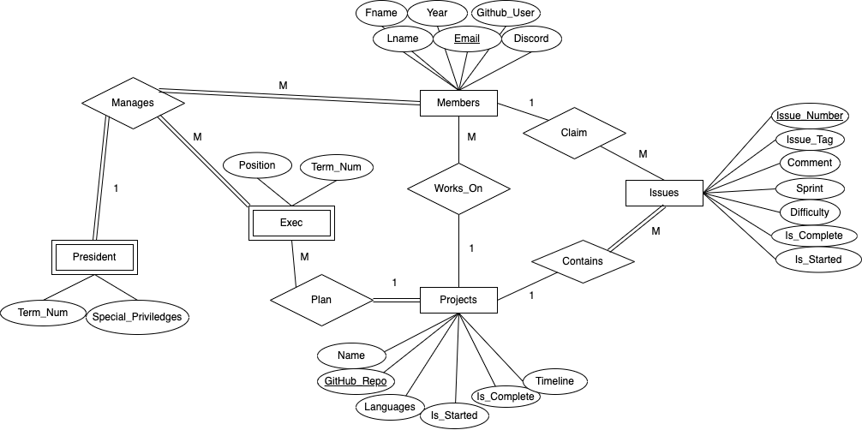
ER Diagram

Slide 5
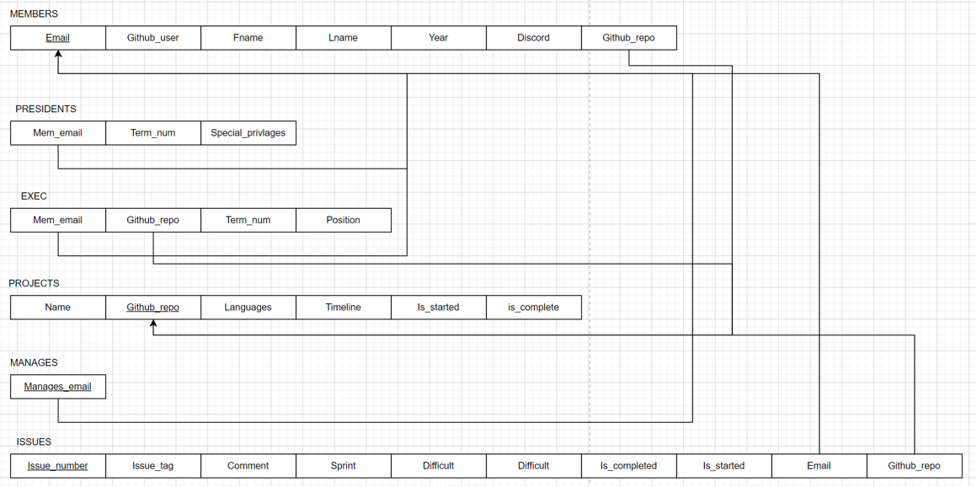
Schema

Slide 6
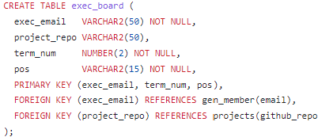
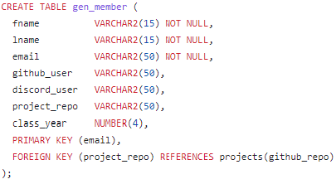
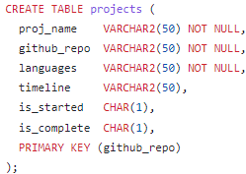
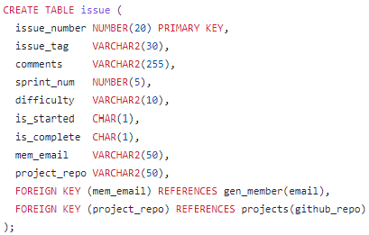
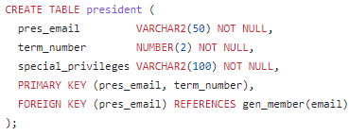
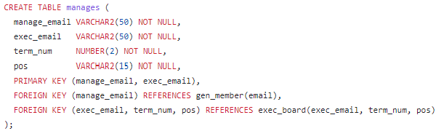
Table Creation

Slide 7
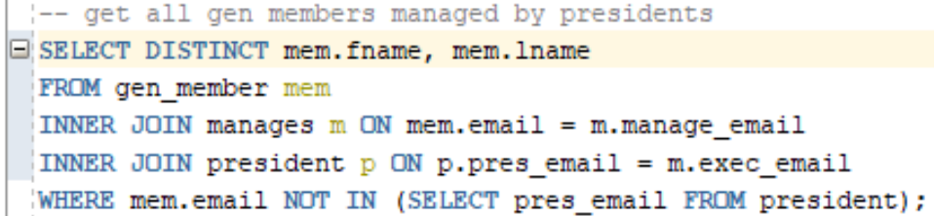
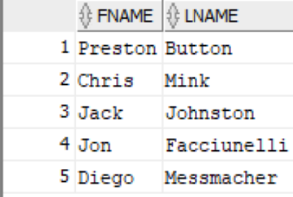
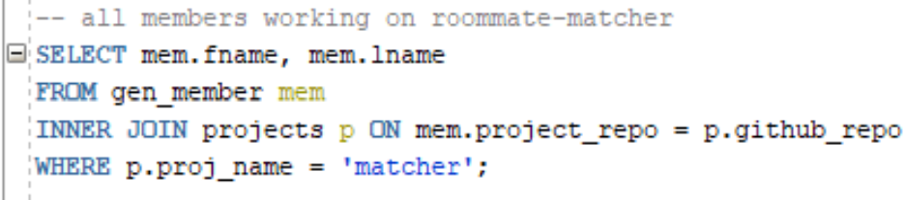
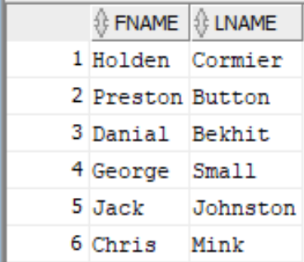
Sample Queries

Slide 8
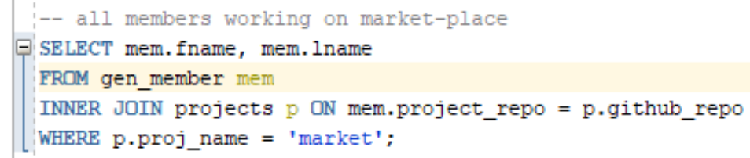
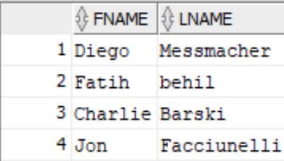
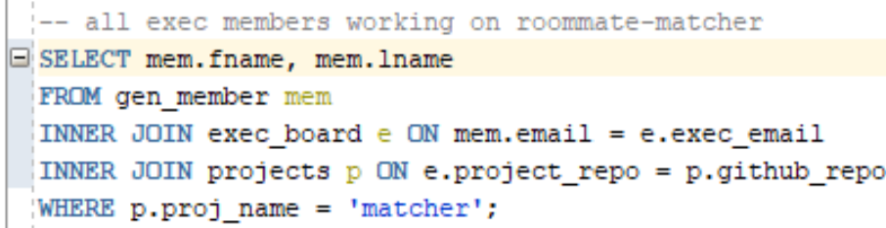
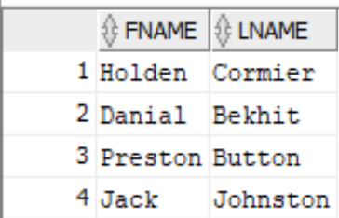
Sample Queries

Slide 9
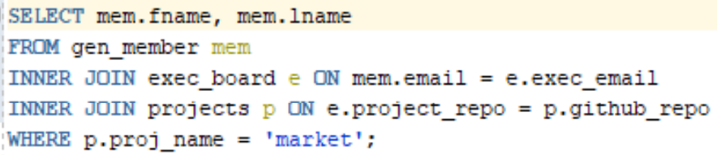
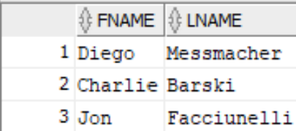
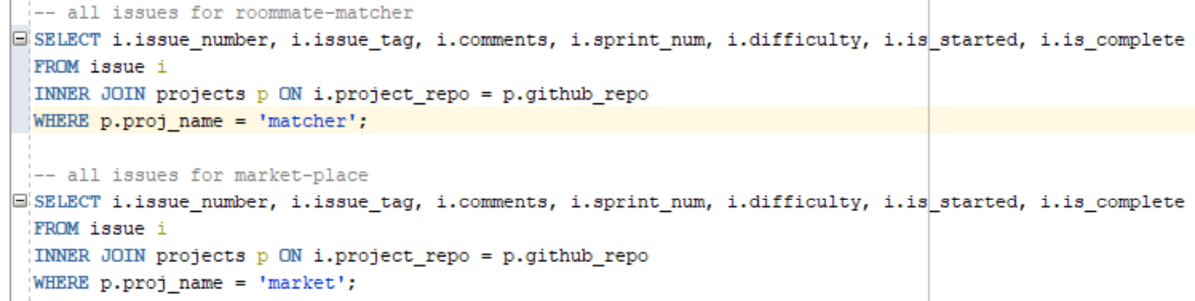
Sample Queries

Slide 10

App Demo

Slide 11
Future Work
Continue to build out the application and make it more automated
Take information from our github and store it rather than us having to manually input the data

